Slide 1
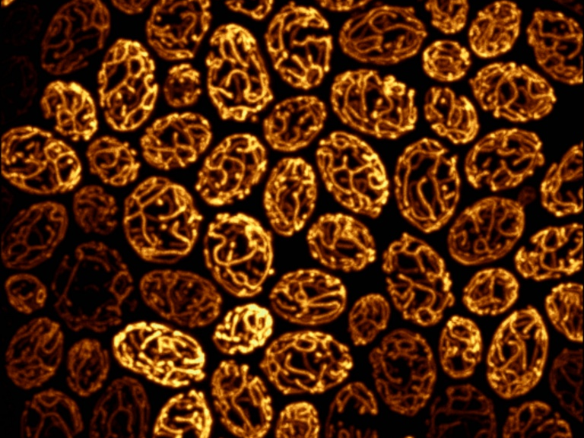
Designing a Microscopy Experiment
Kurt Thorn, PhD
Director, NIC@UCSF
Image from Susanne Rafelski, Marshall lab

Slide 2
The Chinese-menu view of imaging
Imaging Methods
Wide-Field
TIRF
Laser-scanning confocal
Multi-point confocal
Multi-photon confocal
Contrasting techniques
Brightfield, phase, DIC
Immunofluorescence
Physiological dyes
Fluorescent proteins
FRAP, FLIP, photoactivation
FRET, FLIM
Experiment: Time Lapse, 3D, multi-point, multi-wavelength, …

Slide 3
Standard microscope capabilities
Like all rules, these were made to be broken, but only if you have fancy equipment!
Resolution: ~200nm in X and Y, 700 nm in Z
Sensitivity: <100 photons
Linear detection – quantification is possible
Video rate acquisition
4-5 color imaging

Slide 4
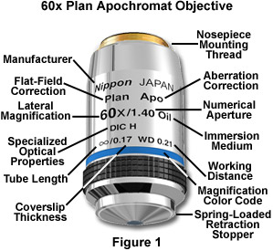
By far the most important part: the Objective Lens
Obviously, we care about the magnification. What other parameters are important?

Slide 5
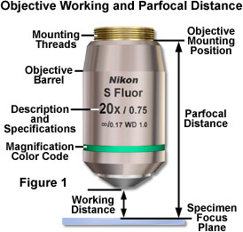
Working Distance
In general, high NA lenses have short working distances
However, extra-long working distance objectives do exist
Some examples:
10x/0.3 WD = 15.2mm
20x/0.75 WD = 1.0mm
100x/1.4 WD = 0.13mm

Slide 6

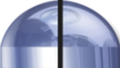
Numerical Aperture
100X / 0.95 NA
α = 71.8°
NA = n sin(α)
4X / 0.20 NA
α = 11.5°
where
= light gathering angle
n = refractive index of sample

Slide 7
Resolution of the Microscope
limited by the point-spread function
Microscope objective collects a limited cone of light from the sample
This limits the resolution achievable by the microscope
Resolution can be measured by the blurring of a point object → the point-spread function
Objective
α
Sample

Slide 8
Resolution of the Microscope
limited by the point-spread function
Microscope objective collects a limited cone of light from the sample
This limits the resolution achievable by the microscope
Resolution can be measured by the blurring of a point object → the point-spread function
Y
X
Z

Slide 9
Resolution of the Microscope
limited by the point-spread function
XY, 0.61λ / NA
Z, λn / NA²
Resolution for some common objectives, in nm:
NA | X-Y | Z
0.3 | 1017 | 16830
0.75 | 407 | 2690
0.95 | 321 | 1680
1.4 | 218 | 770

Slide 10
Light-gathering power
Light-gathering power goes as the square of NA
All things being equal, a higher NA lens will give a brighter image
Increasing magnification generally decreases brightness as light is spread out over more pixels
NA | Brightness
0.3 | 0.09
0.75 | 0.56
0.95 | 0.90
1.4 | 1.96

Slide 11
Choosing an objective
Questions:
What resolution do you need?
How bright is your sample?
For high resolution, you’ll need high NA.
For dim samples, you’ll want high NA, regardless of resolution, to maximize light-gathering.
Dim, low-resolution samples (e.g. protein abundance in nucleus): bin camera to trade off resolution for brightness

Slide 12
Choosing an objective
Questions:
What resolution do you need?
How bright is your sample?
When to use low NA?
Bright samples at low resolution / low magnification
If you need long working distance
If spherical aberration is a concern
If you want large depth of field to get whole structures in focus at once (avoid Z-stacks)

Slide 13
NA, Z-resolution, and Z-stacks
Idea – want to record total nuclear fluorescence
Depth of field
nucleus
High NA
Low NA
nucleus
Need multiple Z-sections to capture entire nucleus
Only need a single image to capture entire nucleus

Slide 14
Confocal Microscopy
Confocal microscopy has the same resolution as widefield, but eliminates out-of-focus light.
This improves contrast for thick, heavily stained specimens.
However, it usually comes at a cost in sensitivity.

Slide 15
Fluorescence Illumination of a single point
Camera
Tube lens
Excitation light
Emission light
Objective lens
Sample
Problem – fluorescence is emitted along entire illuminated cone, not just at focus

Slide 16
The confocal microscope
Detector
Pinhole
Tube lens
Excitation light
Emission light
Objective lens
Sample

Slide 17
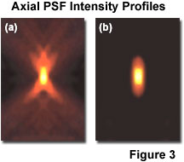
What do you get?

Slide 18
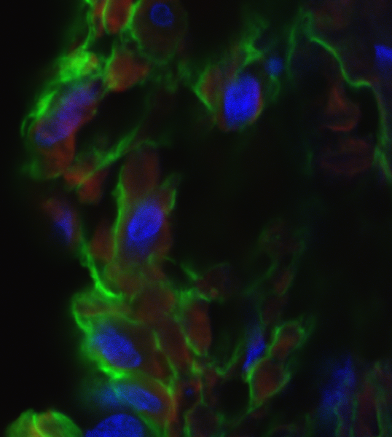
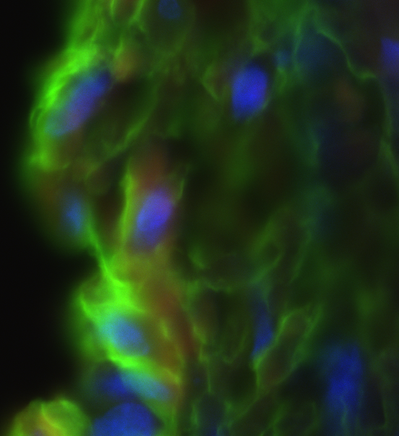
Confocal vs. Widefield
Confocal
Widefield
20 μm rat intestine section recorded with 60x / 1.4NA objective

Slide 19
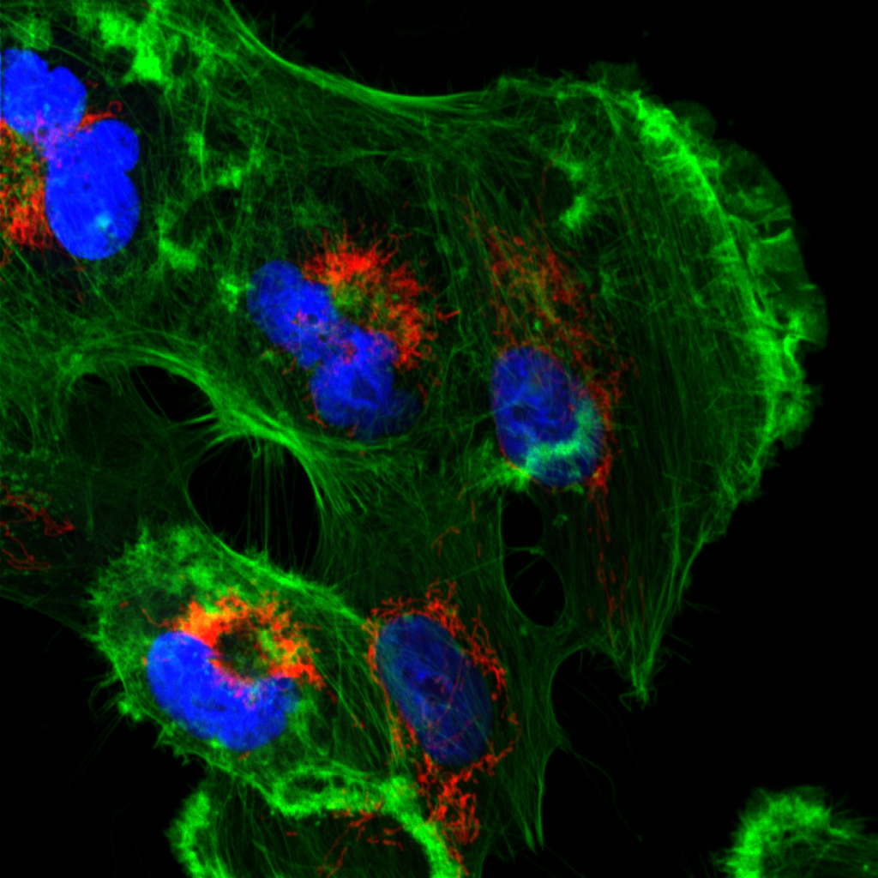
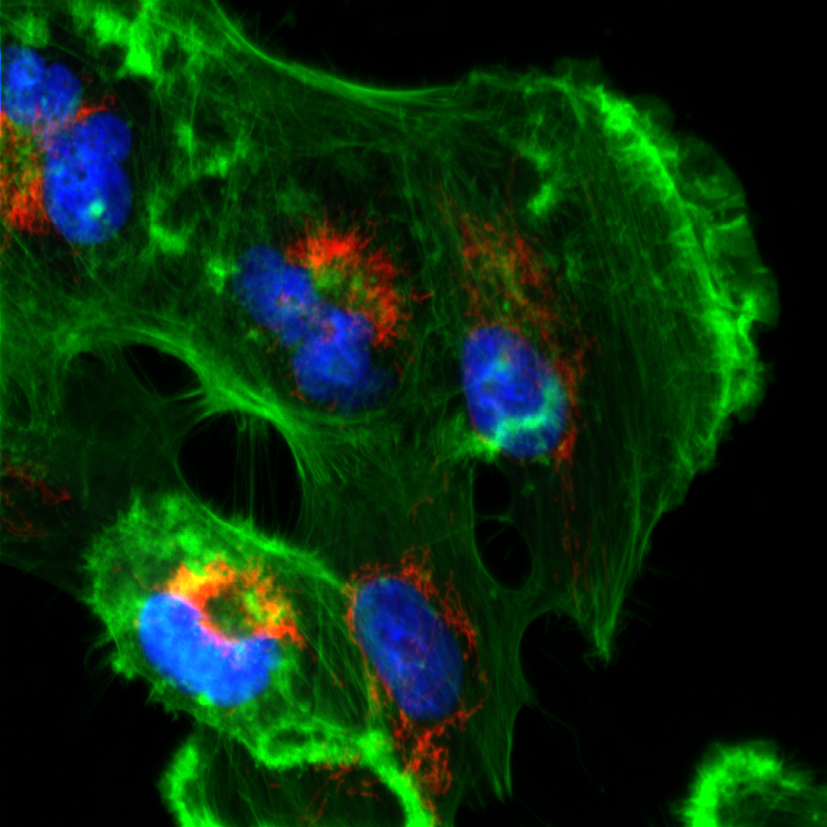
Confocal vs. Widefield
Confocal
Widefield
Tissue culture cell with 60x / 1.4NA objective

Slide 20
The confocal microscope
Scan excitation spot point-by-point to build up image
Problems:
Slow (~1 sec to acquire an image)
Low light efficiency (due to use of PMT as detector)
Solution:
Use multiple pinholes and a camera
Detector
Pinhole
Tube lens
Excitation light
Emission light
Objective lens
Sample

Slide 21
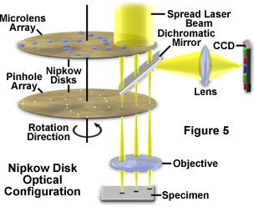
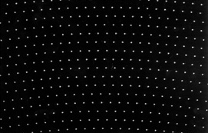
Spinning Disk Confocal

Slide 22
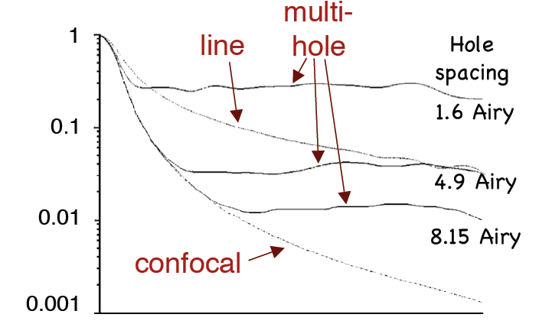
Out-of-focus rejection
T
Defocus

Slide 23
Relative Sensitivity
Widefield 100
Spinning-Disk Confocal 25
Laser-scanning Confocal 1
See Murray JM et al, J. Microscopy 2007 vol. 228 p390-405

Slide 24
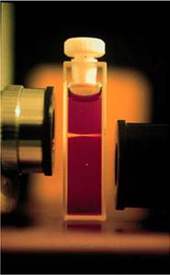
Multi-photon excitation
Internal
conversion
S₁
hν_{A}
hν_{A}
hν_{E}
hν_{A}
S₀
2
1
0
Brad Amos, MRC, Cambridge
Multi-photon excitation does not excite out-of-focus light, so you can get rid of pinhole

Slide 25
Total Internal Reflection: TIRF
Thinnest optical sections: Images ~100nm section adjacent to coverslip
Illuminate through the
objective
Na_{beam}:
1.38
Sample on
cover glass
Intensity
1.42
1.46
Z

Slide 26
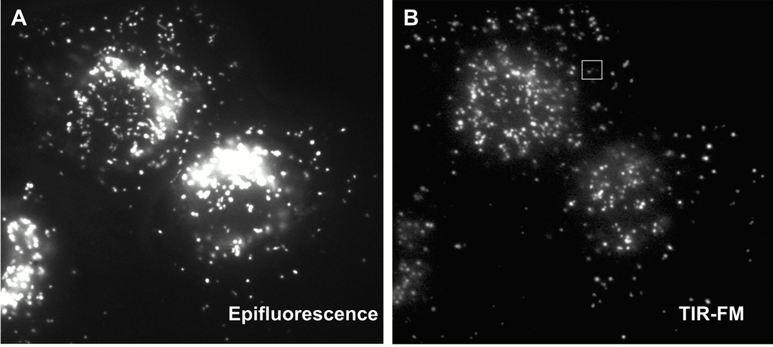
Epifluorescence vs. TIRF
Jaiswal et al 2002; cells loaded with FITC-dextran

Slide 27
Which imaging technique should I use?
1-5 μm
TIRF (for samples at the coverslip)
Wide-field (+deconvolution)
1-20 μm
Fast
Spinning Disk Confocal
Sample Thickness
Sensitivity
10-100 μm
Line-scanning confocal
>20 μm
Point scanning Confocal
Slow
>50 μm
2-photon confocal

Slide 28
Microscope choice
Epifluorescence – routine work, low magnification, or thin samples where you don’t need high-resolution 3D reconstruction
TIRF – samples at the membrane or otherwise at the coverslip surface; very high signal-to-noise; single molecule imaging
Spinning Disk Confocal – Live tissue culture cells, yeast, etc, or thin (<30 μm) tissue sections when you need 3D reconstructions
Laser-Scanning Confocal – Thick tissues or specimens

Slide 29
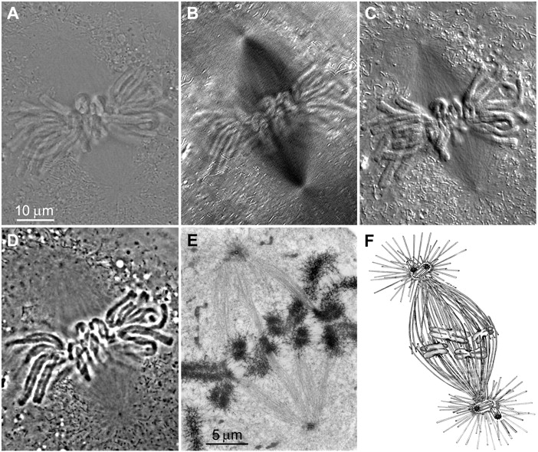
Brightfield Contrasting Techniques
Brightfield
DIC
Phase Contrast
Reider and Khodjakov Science 300: 91-96 (2003)

Slide 30
Brightfield Contrasting Techniques
Both DIC and Phase Contrast can be acquired with fluorescence, but may interfere
Phase Contrast: lose ~5% of fluorescence emission, possibility of increased background due to scatter
DIC: prisms result in splitting of emission light, causing a reduction in resolution

Slide 31
References
Slides: http://nic.ucsf.edu/edu.html

